Slide 1
Preparing for a Public Library Archives Interview
Linda Barrett, CA
Fort Worth Library Archives
City of Fort Worth linda.barrett@fortworthtexas.gov

Slide 2
Getting the Interview
Your cover letter should demonstrate to a potential employer how you are particularly qualified for the position
Your resume should focus on relevant experience
Notes:
Work your way through the job description and incorporate the roles/duties into your cover letter. I recommend highlighting the different elements of the description to make it easier to be sure you address them all. Don’t send the same cover letter or resume to different employers unless they fit the job precisely. Think about how your experience applies to the position– even if it is experience in a different, unrelated profession. Have multiple archives professionals review your cover letter and resume. Take advantage of peer resume review and mock interview opportunities, such as the Career Center at this conference.
One of the biggest differences between applying for positions in public libraries is that the interview tends to be shorter, lasting only an hour or so. Also, you are less likely to be required to do a presentation at your interview.

Slide 3
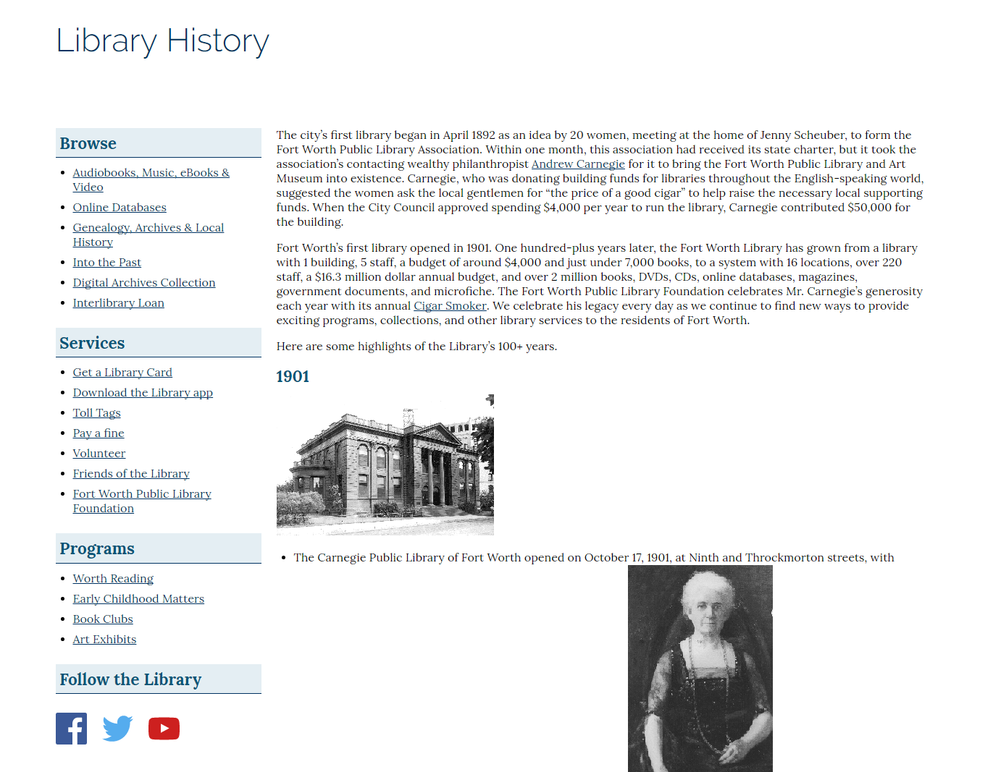
Learn About the Library
Notes:
As an archivist, I can’t think of a situation in which it would not be helpful to know general information about the history of the institution where you are applying to work.

Slide 4
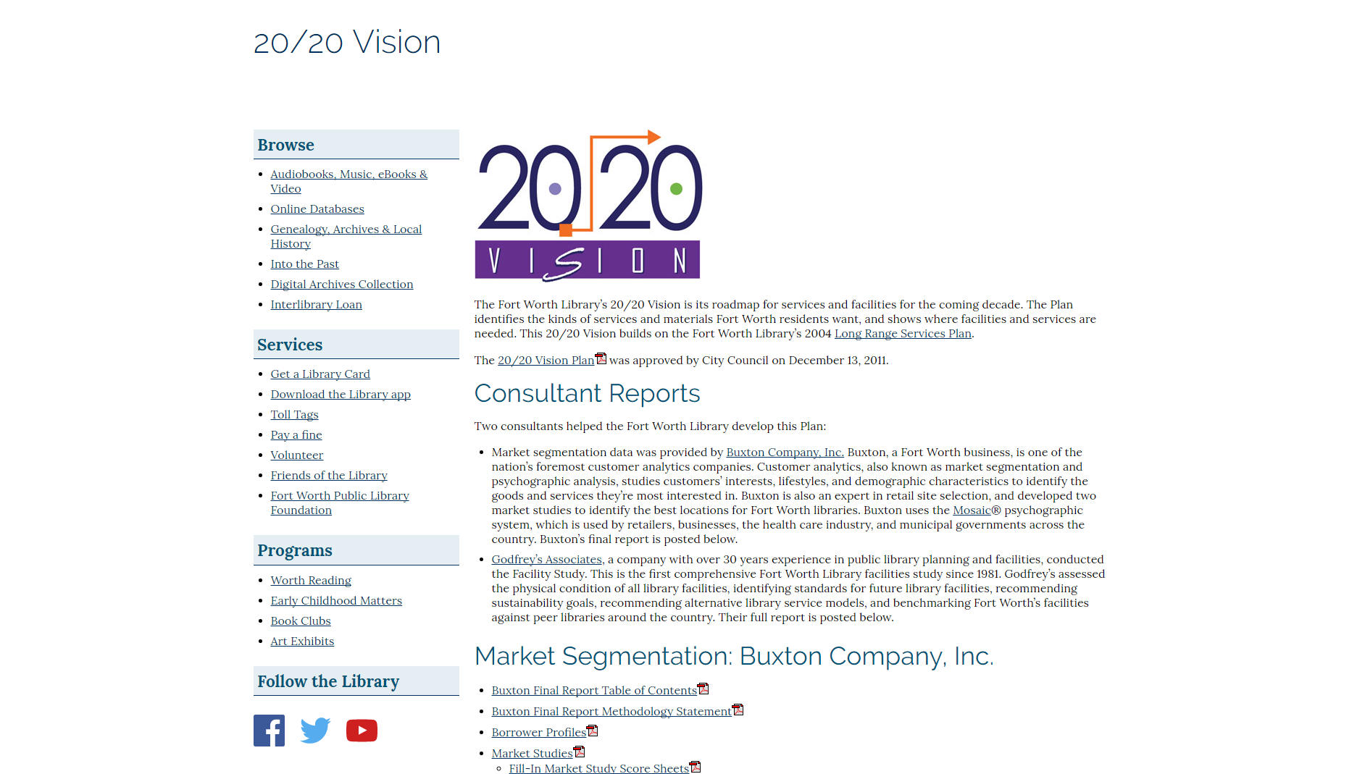
Mission/Vision Statements
Notes:
It is especially important to know about the library’s priorities, which should be outlined in a mission and/or vision statement. If you can’t obtain this information online or by contacting the library, that is something worth knowing, too.

Slide 5
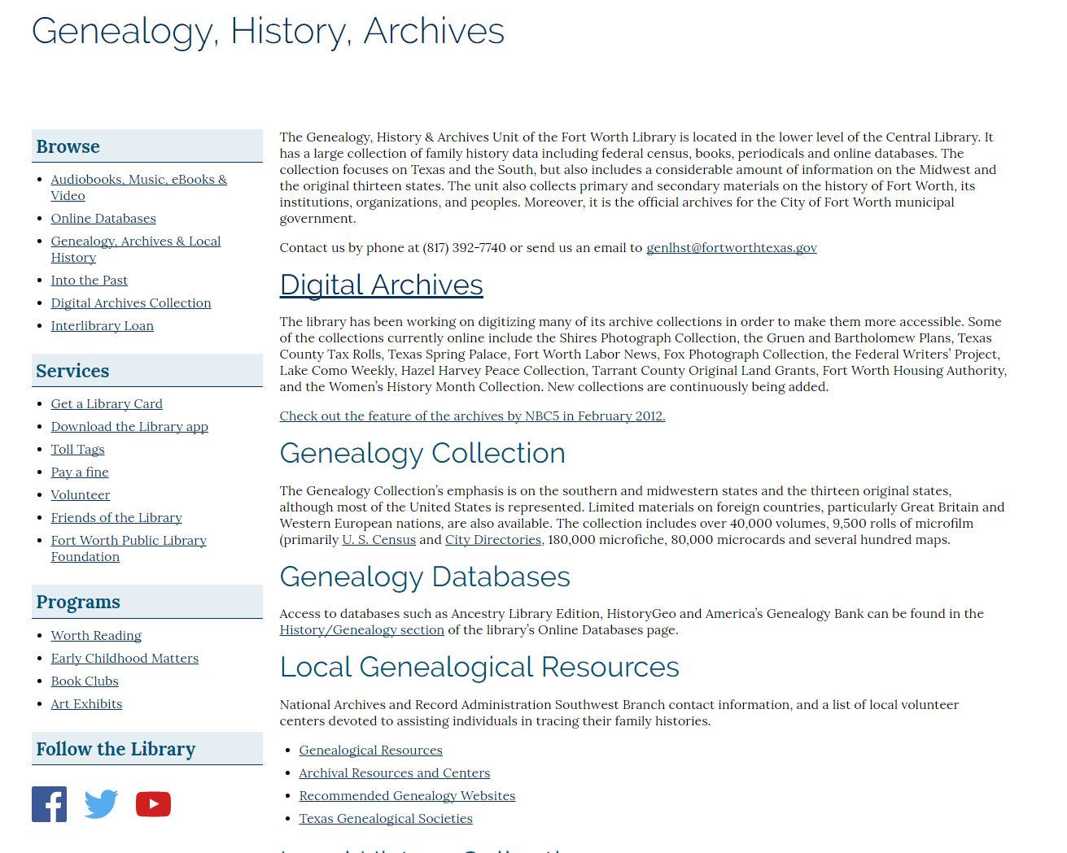
Learn About the Archives
Notes:
If you are applying at an archives that has a presence online, you should familiarize yourself with it. See what resources they are talking about. Don’t forget to look for them on social media, too.

Slide 6
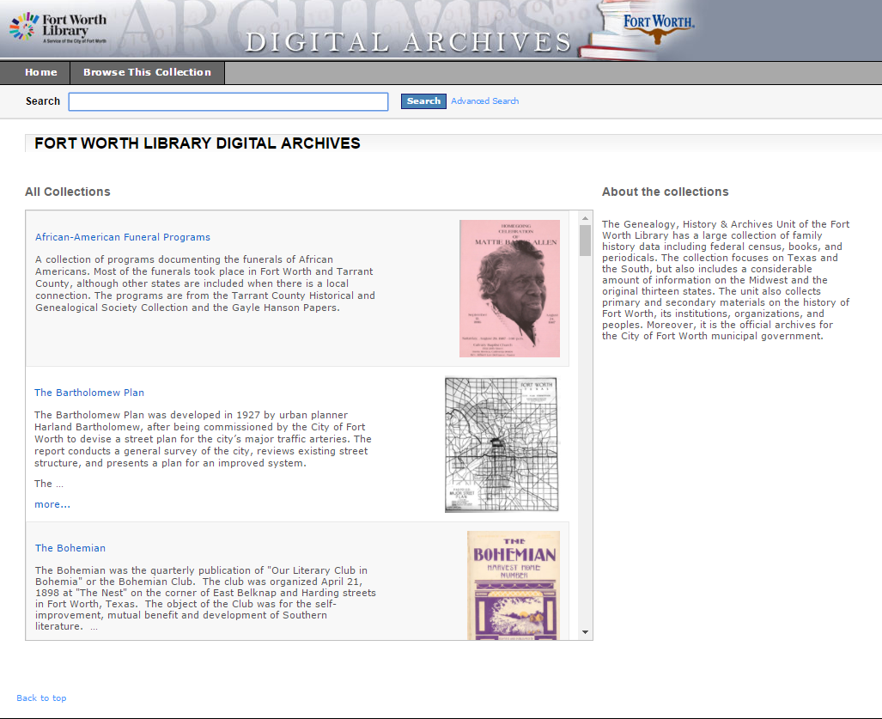
Digital Archives
Notes:
Many public libraries have portals for digital archives where you can learn about some of their collections, and how they present the information.

Slide 7
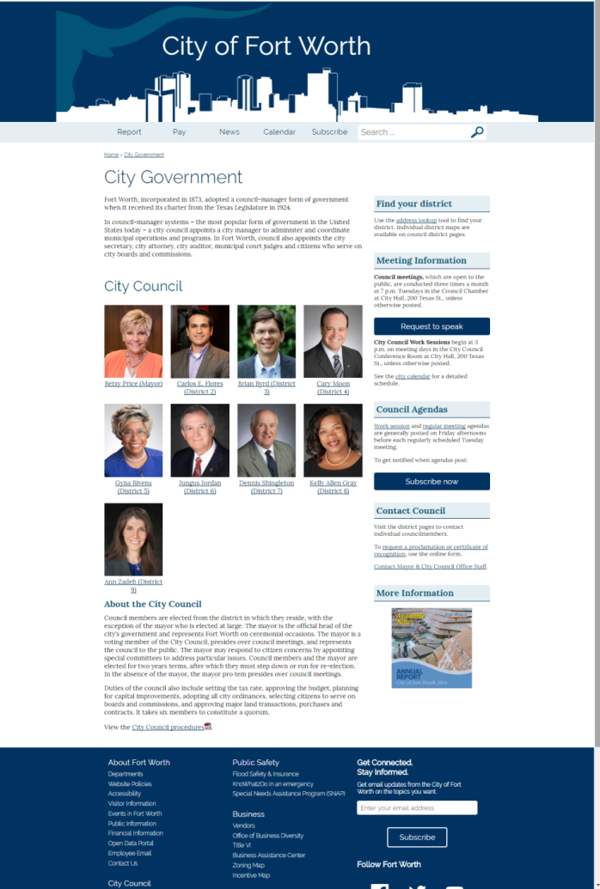
What About the City/County?
Mayor & Council
Council & Manager
Commissioners
Judge
Notes:
It can’t hurt to learn a bit about leadership in the entity where you are applying.

Slide 8
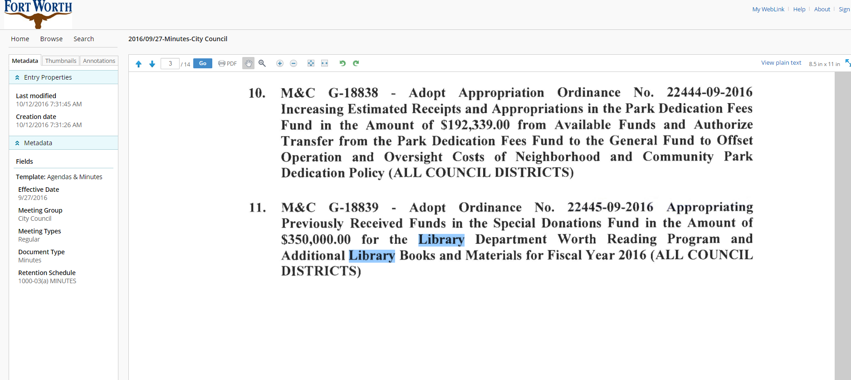
Public Records
Notes:
Depending on the size of the governmental entity where you are applying, records for meetings of the city council or commissioner’s court may be available and searchable online. This can be enlightening.

Slide 9
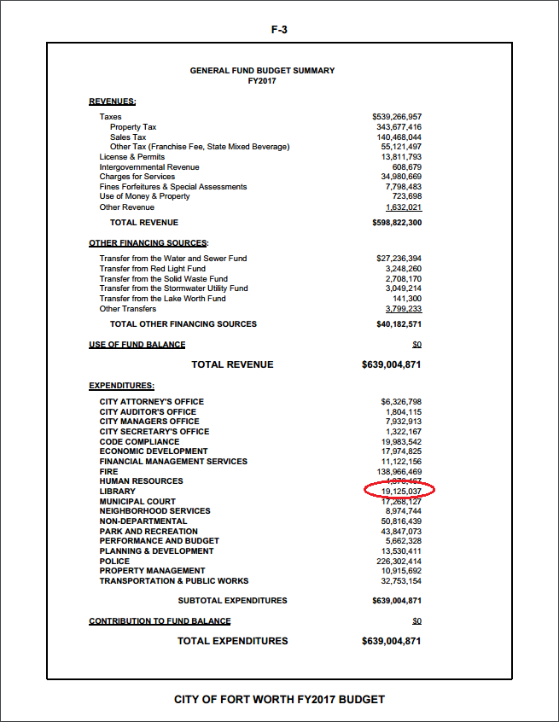
Budget!
Has it gone up or down in recent years?
Does the library budget seem appropriate for the size of the system?
Notes:
City and county budgets are public information, and often available online. You might want to look up the last few years to see if the budget has changed significantly, and if so, why.
This type of information will also help you be able to asked informed questions. You might want to learn about the chain of command, if possible. Who does the director report to? The mayor? A city manager?

Slide 10
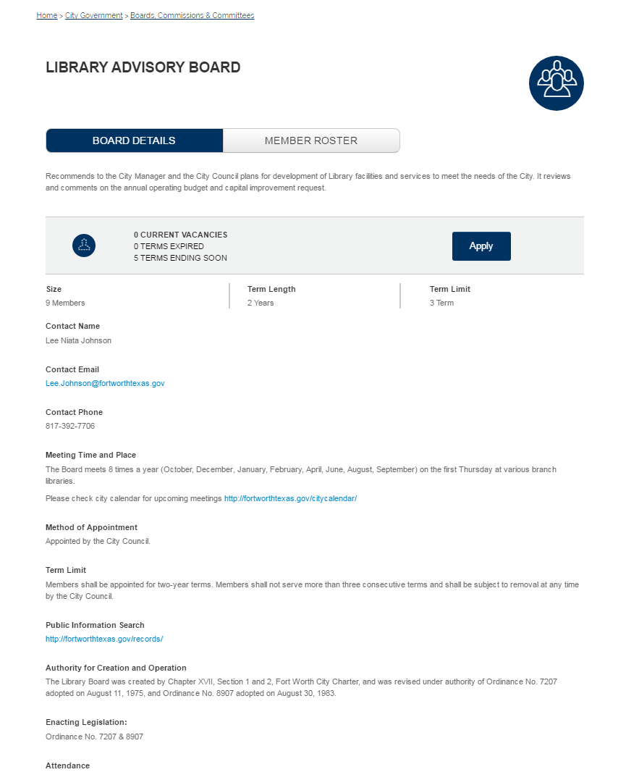
Support Organizations
Notes:
Does the system have an advisory board? The Fort Worth Advisory Board recommends to the City Manager and the City Council plans for development of Library facilities and services to meet the needs of the City. It reviews and comments on the annual operating budget and capital improvement requests.

Slide 11
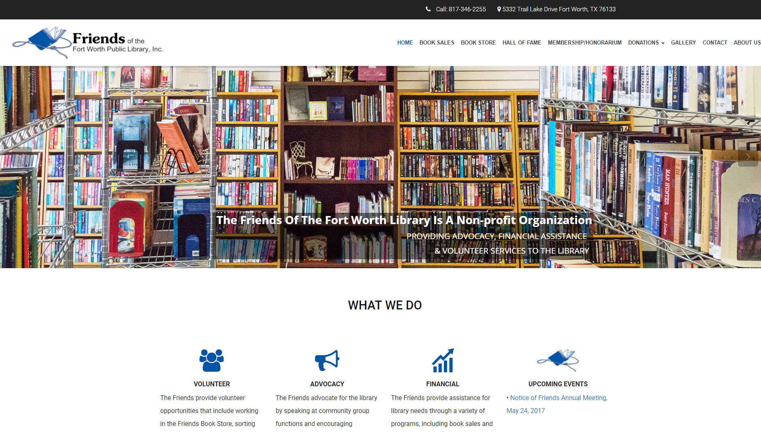
Support Organizations
Notes:
Many public libraries have a “Friends of the Library” organization that raises money and advocates for them. In some areas, the friends group provides a solution to the issue of what to do with weeded books by selling them in a used book store.

Slide 12
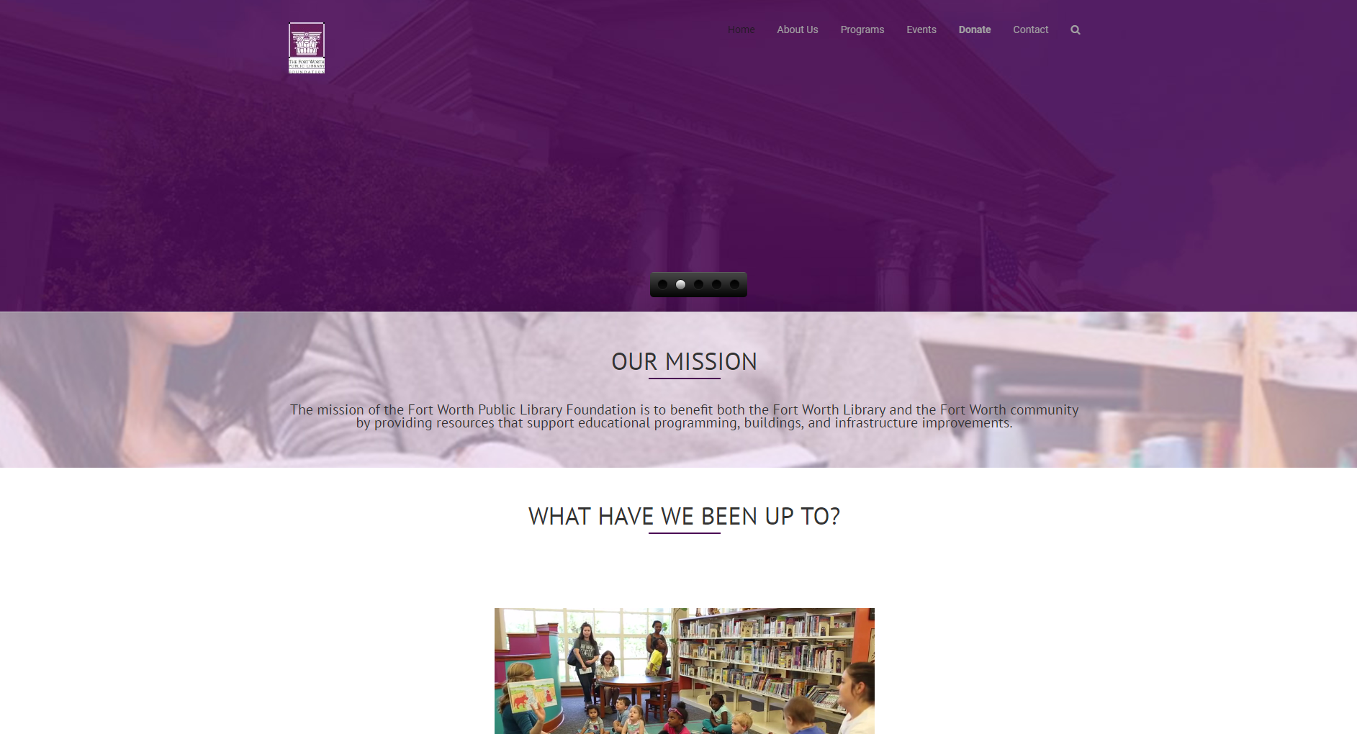
Support Organizations
Notes:
Some libraries have foundations that also provided funding and support for various purposes. The mission of the Fort Worth Public Library Foundation is to benefit both the Fort Worth Library and the Fort Worth community by providing resources that support educational programming, buildings, and infrastructure improvements.

Slide 13
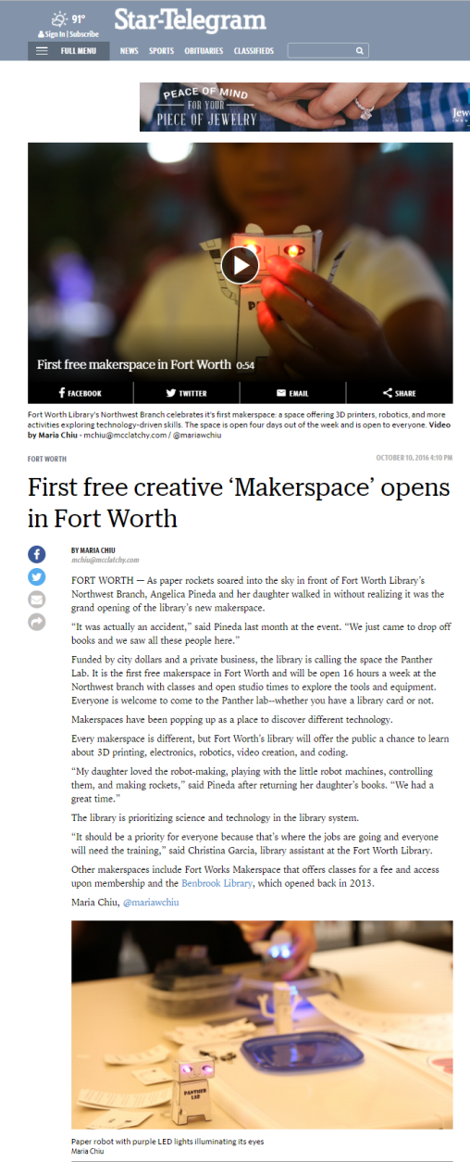
Local Newspapers
Get a feel for what is going on at the library
Search for stories pertaining to the archives
Notes:
If the archives has been in a major news story, knowledge of it shows that you have done some research. Articles about the library and archives will help you be aware of the culture of the system so you don’t inadvertently bring up something awkward. Search for information with names or titles of those in leadership roles such as the mayor, city manager, director of the library, or archivist, combined with the keywords “library” and “archives”.

Slide 14
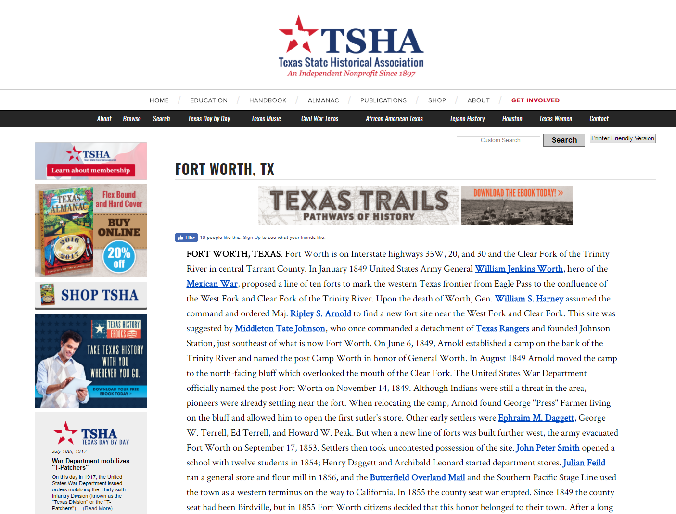
Learn About the Region
Notes:
For a public library archives position, it is helpful to be conversant in the history of the geographical area, but if you are not from the area it is understandable that you probably won’t be an expert.

Slide 15
Other Tips
Don’t list collections that you have worked with unless they are well-known
Do make generalized statements on the types of collections you have worked with, and the type of work you were involved with
Be prepared to discuss your philosophy regarding archival processing and management
Find archives interview questions and practice!
Notes:
Even if it you are not applying for a management position, I think it is a good idea to be able to articulate your personal philosophy, as this can demonstrate your knowledge of archives and how they successfully meet the needs of their users. Think of what have been the greatest challenges you have encountered as a professional and be prepared to discuss them as well as how you dealt with them. While it might be better to have an example for the archives profession, being able to discuss a problem that can be translated to the position you are applying for should be sufficient.

